Slide 1

SWD 392 - Software Architecture and Design

Slide 2
19 Designing Software Product Line Architectures
SWD391

Slide 3
1
Evolutionary Software Product Line Engineering

Slide 4
The software process model for SPL engineering is a highly iterative software process that eliminates the traditional distinction between software development and maintenance.
Furthermore, because new software systems are outgrowths of existing ones, the process takes a SPL perspective; it consists of two main processes:
SPL Engineering
Software Application Engineering.

Slide 5
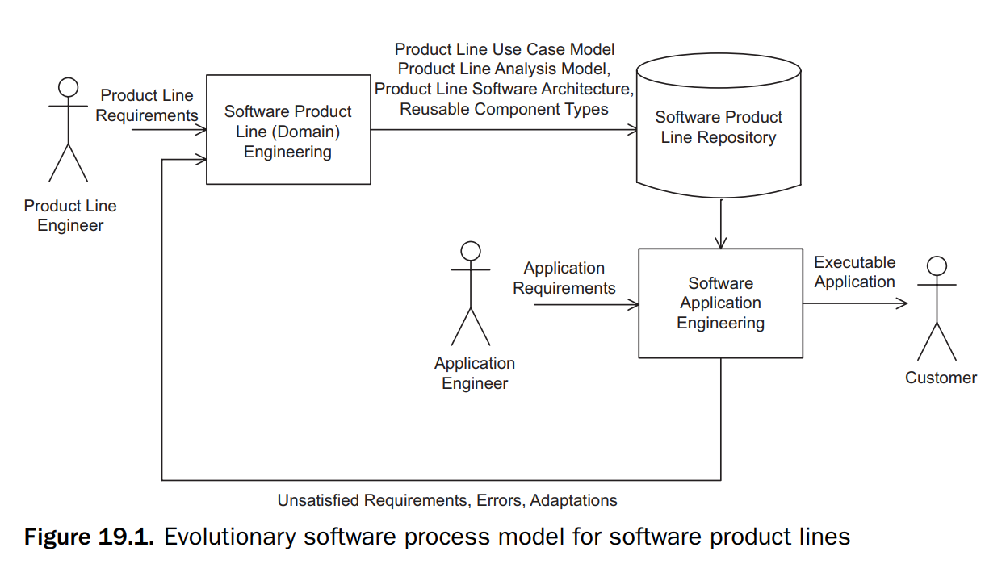

Slide 6
SPL Engineering
Also known as domain engineering.
A product line multiple-view model that addresses the multiple views of a SPL is developed. The product line multiple-view model, product line architecture, and reusable components are developed and stored in the product line repository.

Slide 7
Software Application Engineering
A software application multiple-view model is an individual product line member derived from the SPL multiple-view model.
The user selects the required features for the individual product line member. Given the features, the product line model and architecture are adapted and tailored to derive the application architecture.
The architecture determines which of the reusable components are needed for deriving and configuring the executable application.

Slide 8
2
REQUIREMENTS MODELING FOR SOFTWARE PRODUCT LINES

Slide 9
For single systems, use case modeling is the primary vehicle for describing software functional requirements.
For SPLs, feature modeling is an additional important part of requirements modeling.
The strength of feature modeling is in differentiating between the functionality provided by the different family members of the product line in terms of common functionality, optional functionality, and alternative functionality

Slide 10
2.1 Use Case Modeling for Software Product Lines
For a single system, all use cases are required.
In a SPL, only some of the use cases, which are referred to as kernel use cases, are required by all members of the family. Other use cases are optional, in that they are required by some but not all members of the family. Some use cases might be alternatives to each other.

Slide 11
2.1 Use Case Modeling for Software Product Lines
In UML, the use cases are labeled with the stereotype «kernel», «optional» or «alternative».
In addition, variability can be inserted into a use case through variation points, which specify locations in the use case where variability can be introduced.
Variation points are provided for both the kernel and optional use cases. One variation point concerns the display prompt language.

Slide 12
2.2 Feature Modeling
Feature modeling is an important modeling view for product line engineering because it addresses SPL variability.
Features are analyzed and categorized as:
common features (must be supported in all product line members)
optional features (only required in some product line members)
alternative features (a choice of feature is available)
prerequisite features (dependent upon other features)

Slide 13
2.2 Feature Modeling
The emphasis in feature modeling is capturing the product line variability, as given by optional and alternative features, because these features differentiate one member of the product family from the others.

Slide 14
2.2 Feature Modeling
Features are used widely in product line engineering but are not typically used in UML. In order to effectively model product lines, it is necessary to incorporate feature modeling concepts into UML.
Features are incorporated into UML in the PLUS method using the meta-class concept, in which features are modeled using the UML static modeling notation and given stereotypes to differentiate between:
«common feature»
«optional feature»
«alternative feature»

Slide 15
2.2 Feature Modeling
Feature groups, which place a constraint on how certain features can be selected for a product line member, such as mutually exclusive features, are also modeled using meta-classes and given stereotypes.
A feature group is modeled as an aggregation of features, because a feature is part of a feature group.

Slide 16
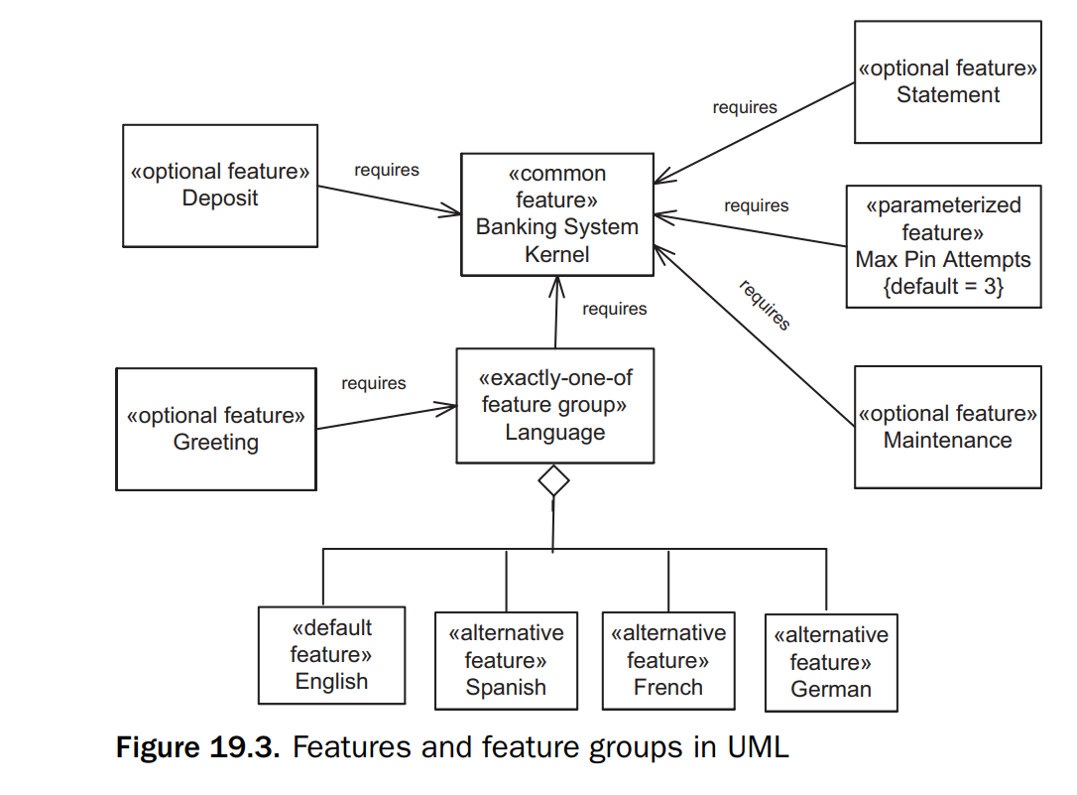
2.2 Feature Modeling

Slide 17
2.2 Feature Modeling
In single systems, use cases are used to determine the functional requirements of a system; they can also serve this purpose in product families.
The goal of the use case analysis is to get a good understanding of the functional requirements.
Whereas the goal of feature analysis is to enable reuse.
Use cases and features complement each other; thus, optional and alternative use cases are mapped to optional and alternative features, respectively, whereas use case variation points are also mapped to features.

Slide 18
2.2 Feature Modeling
The relationship between use cases and features can be explicitly depicted in a feature/use case relationship table.

Slide 19
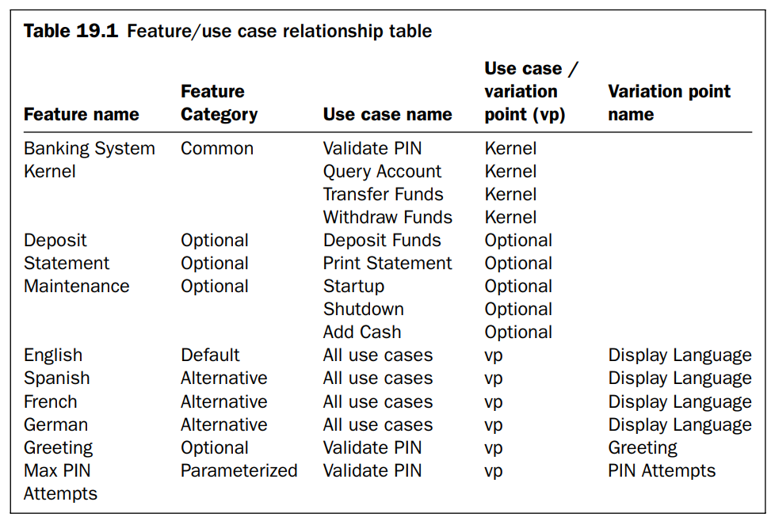
2.2 Feature Modeling

Slide 20
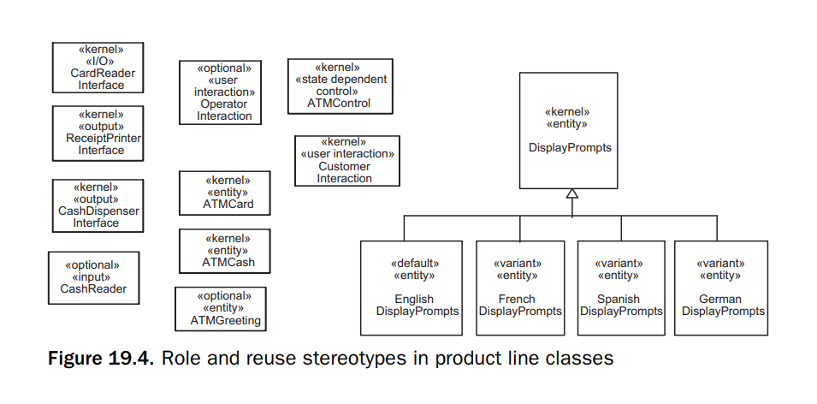
2.2 Feature Modeling

Slide 21
3
ANALYSIS MODELING FOR SOFTWARE PRODUCT LINES

Slide 22
As with single systems, analysis modeling consists of both static and dynamic modeling.
However, both modeling approaches need to address modeling SPL variability

Slide 23
3.1 Static Modeling for Software Product Lines
In single systems, a class is categorized by the role it plays. Application classes are classified according to their role in the application using stereotypes such as:
«entity class»
«control class»
«boundary class»
In modeling SPLs, each class can also be categorized according to its reuse characteristic using the stereotypes:
«kernel»
«optional»
«variant»

Slide 24
3.1 Static Modeling for Software Product Lines
In UML, a modeling element can be described with more than one stereotype. Thus, one stereotype can be used to represent the reuse characteristic, whereas a different stereotype is used to represent the role played by the modeling element.
The role a class plays in the application and the reuse characteristic are orthogonal.

Slide 25
3.2 Dynamic Interaction Modeling for SPLs
Dynamic modeling for SPLs uses an iterative strategy called evolutionary dynamic analysis to help determine the dynamic impact of each feature on the software architecture.
This results in new components being added or existing components having to be adapted.

Slide 26
3.2 Dynamic Interaction Modeling for SPLs
The kernel system is a minimal member of the product line. In some product lines, the kernel system consists of only the kernel objects; for other product lines, some default objects may be needed in addition to the kernel objects.
The kernel system is developed by considering the kernel use cases, which are required by every member for the product line.

Slide 27
3.2 Dynamic Interaction Modeling for SPLs
For each kernel use case, a communication diagram is developed depicting the objects needed to realize the use case.
The kernel system is determined by integrating the kernel use case–based communication diagrams to depict all the objects in the kernel system and the message communication between them.
The next step is to determine the classes from which these objects are instantiated.

Slide 28
3.2 Dynamic Interaction Modeling for SPLs
The software product line evolution approach starts with the kernel system and considers the impact of optional and/or alternative features. This results in the addition of optional or variant objects to the product line architecture.
This analysis is done by considering the variable (optional and alternative) use cases, as well as any variation points in the kernel or variable use cases. For each optional or alternative use case, an interaction diagram is developed consisting of new optional or variant objects.
The variant objects are kernel or optional objects that are impacted by the variable scenarios and therefore need to be adapted.

Slide 29
3.2 Dynamic Interaction Modeling for SPLs
The relationship between features and the classes can be depicted on a feature/class dependency table.
This table shows for each feature the classes that realize the feature, as well as the class reuse category (kernel, optional, or variant), and, in the case of a parameterized class, the class parameter.
This table is developed after the dynamic impact analysis has been carried out using evolutionary dynamic analysis.

Slide 30
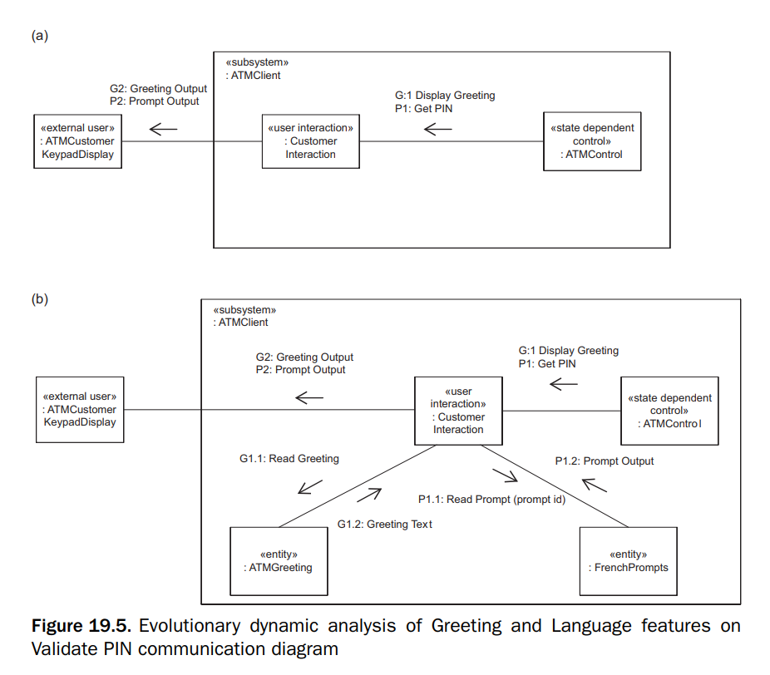
3.2 Dynamic Interaction Modeling for SPLs

Slide 31
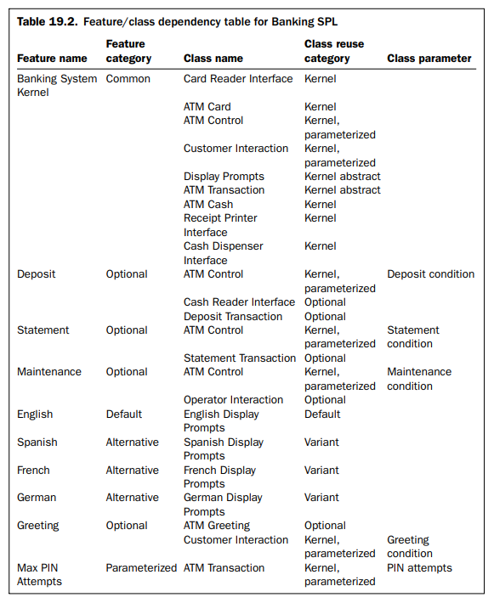
3.2 Dynamic Interaction Modeling for SPLs

Slide 32
4
DYNAMIC STATE MACHINE MODELING FOR SOFTWARE PRODUCT LINES

Slide 33
When variable classes are developed, there are two main approaches to consider, specialization or parameterization.
Specialization is effective when there are a relatively small number of changes to be made, so that the number of specialized classes is manageable.
In product line development, however, there can be a large degree of variability. This variability can be handled by using either parameterized state machines or specialized state machines.

Slide 34
Depending on whether the product line uses a centralized or decentralized approach, it is likely that there will be several different state-dependent control classes, each modeled by its own state machine.

Slide 35
To capture state machine variability and evolution, it is necessary to specify optional states, events and state transitions, and actions.
A further decision that needs to be made is whether to use state machine inheritance or parameterization.
The problem with using inheritance is that a different state machine is needed to model each alternative or optional feature, or feature combination, which rapidly leads to a combinatorial explosion of inherited state machines.

Slide 36
It is often more effective to design a parameterized state machine, in which there are feature-dependent states, events, and transitions.
Optional state transitions are specified by having an event qualified by a Boolean feature condition, which guards entry into the state.
Optional actions are also guarded by a Boolean feature condition, which is set to True if the feature is selected and False if the feature is not selected for a given SPL member.

Slide 37
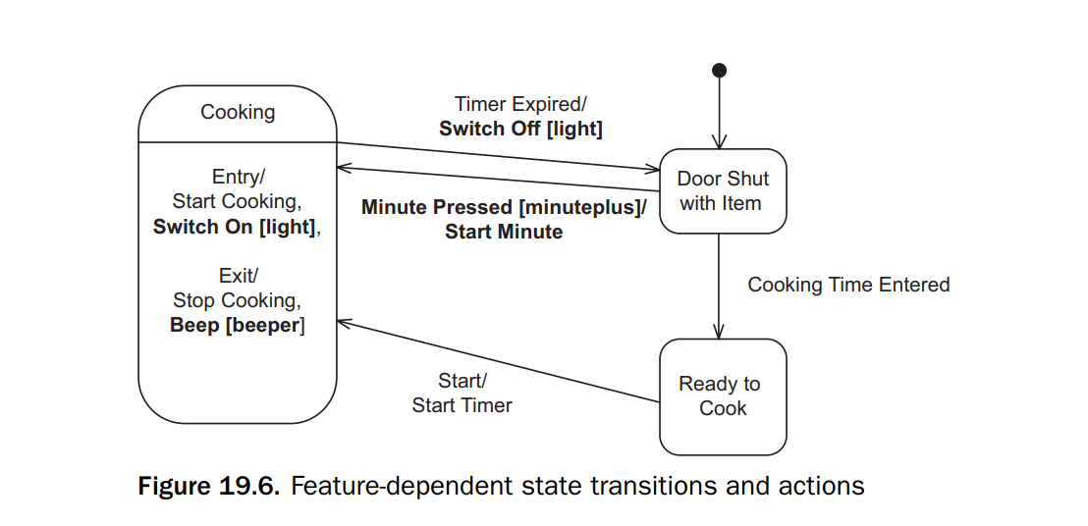

Slide 38
5
DESIGN MODELING FOR SOFTWARE PRODUCT LINES

Slide 39
5.1 Modeling Component-Based Software Architectures
A software component’s interface is specified separately from its implementation, and, unlike a class, the component’s required interface is designed explicitly in addition to the provided interface.
This is particularly important for architecture-centric evolution, because it is necessary to know the impact of the change to a component on all components that interface to it.

Slide 40
5.1 Modeling Component-Based Software Architectures
This capability for modeling component-based software architectures is particularly valuable in product line engineering, to allow the development of kernel, optional and variant components, “plug-compatible” components, and component interface inheritance.
There are various ways to design components. It is highly desirable, where possible, to design components that are plug-compatible, so that the required port of one component is compatible with the provided ports of other components to which it needs to connect.

Slide 41
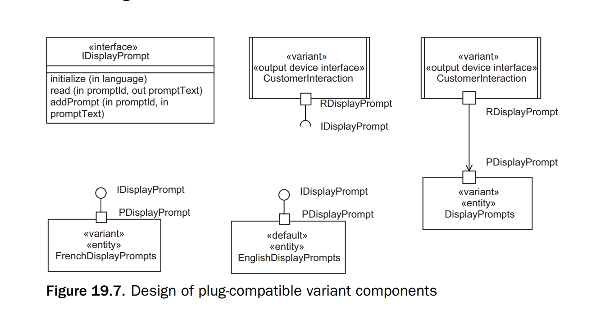
5.1 Modeling Component-Based Software Architectures

Slide 42
5.1 Modeling Component-Based Software Architectures
It is possible for a component to connect to different components and have different interconnections such that in one case it communicates with one component and in a different case it communicates with two different components.
This flexibility helps in evolving the software architecture.

Slide 43
5.1 Modeling Component-Based Software Architectures
When plug-compatible components are not practical, an alternative component design approach is component interface inheritance.
Consider a component architecture that evolves in such a way that the interface through which the two components communicate needs to be specialized to allow for additional functionality.
In this case, both the component that provides the interface and the component that requires the interface have to be modified – the former to realize the new functionality, and the latter to request it.

Slide 44
5.2 Software Architectural Patterns
Software architectural patterns provide the skeleton or template for the overall software architecture or high-level design of an application. These include such widely used architectures as client/server and layered architectures.
Basing the software architecture of a product line on one or more software architectural patterns helps in designing the original architecture as well as evolving the architecture.

Slide 45
5.2 Software Architectural Patterns
Most software systems and product lines can be based on well-understood overall software architectures; for example, the client/server software architecture is prevalent in many software applications.
There is the basic client/service architectural pattern, with one service and many clients, but there are also many variations on this theme, such as the Multiple Client/Multiple Service architectural patterns and Broker patterns.

Slide 46
5.2 Software Architectural Patterns
With a client/service pattern, services can evolve with the addition of new services that are discovered and invoked by clients.
New clients can be added that discover services provided by one or more service providers.

Slide 47
5.2 Software Architectural Patterns
An architectural pattern that is worth considering because of its desirable properties for SPLs is the Layered architectural pattern.
A layered architectural pattern allows for ease of extension and contraction because components can be added to or removed from higher layers, which use the services provided by components at lower layers of the architecture.

Slide 48
Thanks!
CREDITS: This presentation template was created by Slidesgo, including icons by Flaticon, infographics & images by Freepik

